Slide 1
Autoscaling in Reality
Lessons learned adaptively scaling Kubernetes
Notes:
-talk to you about our adventures and lessons learned building our own autoscaler, and share some learnings in case you decide to go down the same route

Slide 2
Who am I?
Andy Kwiatkowski
Senior Production Engineer
Shopify
Notes:
-been at shopify about 1 ½ yers
-learned tons!

Slide 3
Shopify Scale
1,000,000+ Merchants
$100k merchants sales/minute (2018)
Peak around 10 million+ request per min (2018)
50 kubernetes clusters, 10000s+ replicas
Deploy new version of Shopify 40 times each day
Notes:
-pretty good scale
-large enough were server costs really start to matter

Slide 4
Datacenter → Cloud
2018 Shopify moved all of our servers from our own data centers to the cloud
Higher than expected costs for our app servers
“Datacenter thinking” was not going to work for scaling web servers in the cloud

Slide 5
Day/Night cycle
Requests Per Minute during a Typical Week

Slide 6
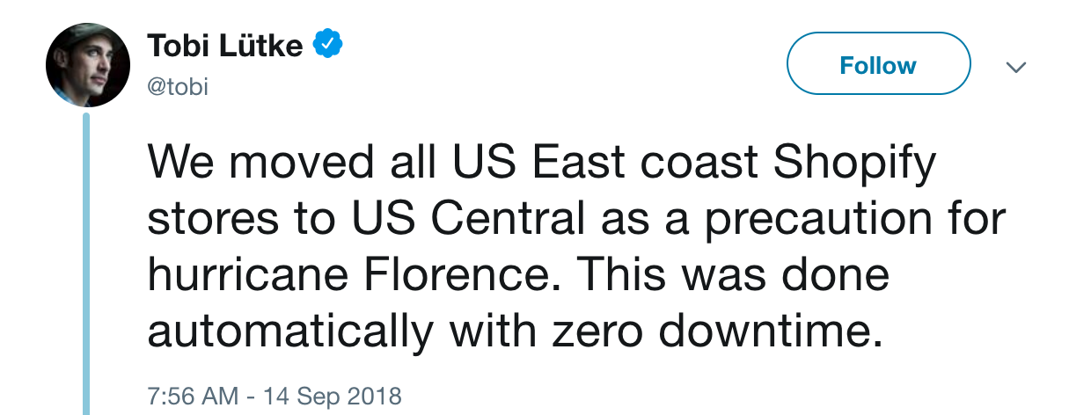
Notes:
It gets worse

Slide 7
Failovers

Slide 8
Failovers
Notes:
-actual cpu utilization for a cluster in Feb

Slide 9
Failovers
Wasted Resources!
Notes:
-actual cpu utilization for a cluster in Feb

Slide 10
Autoscaling can help!
Autoscaling Basics
Why we created a custom Autoscaler
Unexpected Features
Algorithm Tuning
Safety
When to take the plunge

Slide 11
Autoscaling 101
Have enough capacity to serve traffic
Reduce idle server time (save money)
Limit unnecessary scaling up/down

Slide 12
“Busy-ness” Signal # of replicas
How many servers (replicas) do we need?
Requests-per-minute
CPU Utilization
Queue Length
...

Slide 13
Autoscaling 101
Noisy
Trending upwards
Notes:
-sample traffic pattern (RPM, or utilization or whatever)
-noisy
-steadily going up
-take this signal and set amount of servers we need
-don’t want to go up/down too much because of starting/restating your app - wastes time and rouses, and other reasons described later

Slide 14
Minimum Replica Change
Only perform scaling if change in replicas is greater than X
Notes:
-sample traffic pattern (RPM, or utilization or whatever)
-noisy
-steadily going up
-take this signal and set amount of servers we need
-don’t want to go up/down too much because of starting/restating your app - wastes time and rouses, and other reasons described later

Slide 15
Running Average
Notes:
-sample traffic pattern (RPM, or utilization or whatever)
-noisy
-steadily going up
-take this signal and set amount of servers we need
-don’t want to go up/down too much because of starting/restating your app - wastes time and rouses, and other reasons described later

Slide 16
Why not just use existing solutions?
Notes:
-you can!
-controlled, safety, tested

Slide 17
Scaling up can be slow.

Slide 18
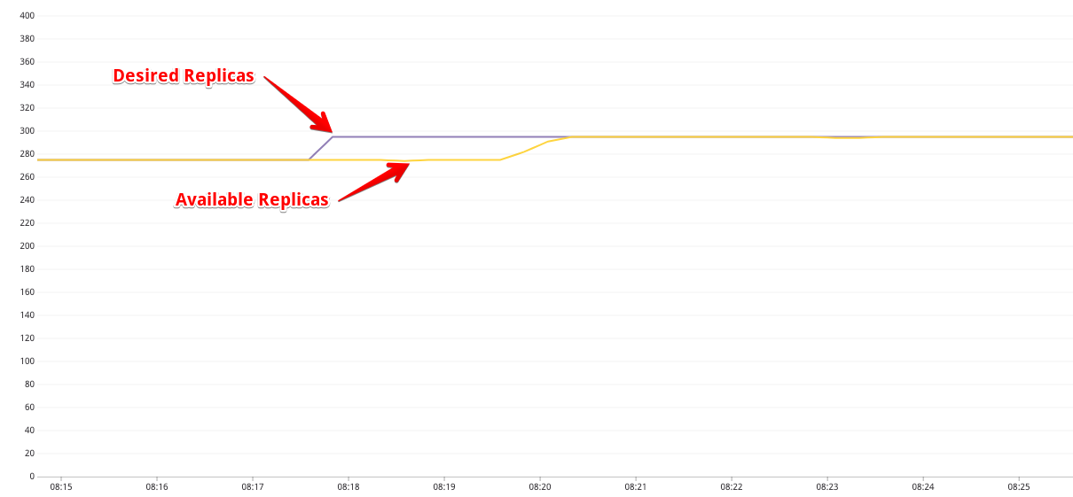
Scaling up can be slow

Slide 19
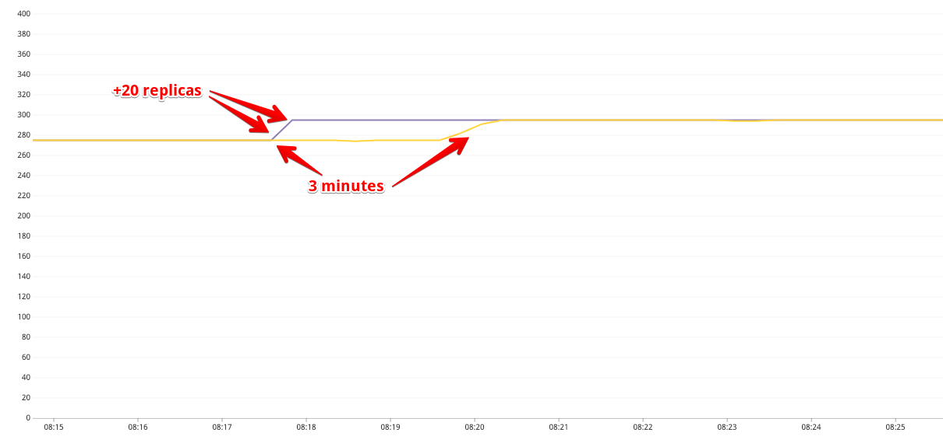
Scaling up can be slow
Notes:
-if all scaling worked like this we’d be good

Slide 20
Flash sales
Large, sudden influx of requests
Typically short-lived (less than 15 minutes), but sometimes lasts several hours

Slide 21
Flash sales
50% spike in traffic

Slide 22
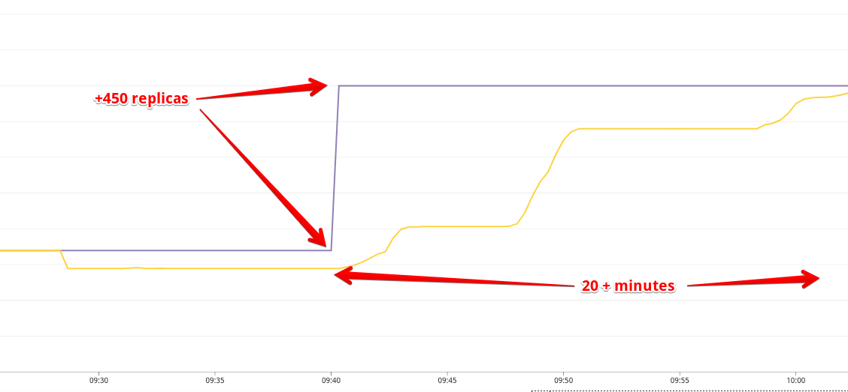
Scaling up can be slow
Notes:
Much worse with more replicas/resources

Slide 23
Scaling up can be slow
Spinning up new nodes
Copying Docker images
Booting up applications, daemon sets
Can take anywhere from 2 to 20 minutes
Way too slow for handling large influx of traffic (i.e. flash sales or failovers)

Slide 24
Writing a custom Autoscaler
Flash sales
Safety
Handle continuous deployment efficiently!
Optimize noise reduction and incident detection!
More complex scaling conditions!
Notes:
-flash sales and failovers were why we created autoscaler
-as we built it we discovered bonus features

Slide 25
Shopify Core Autoscaler
App written in Go
Runs one instance on each cluster
Main function: Set K8S deployment replica count on our core app
kubectl scale deployment/web --replicas=XXX
Notes:
Estimate about 8-man months

Slide 26
Scheduled flash sales!
Notes:
-spy CLI based tool we can run in slack

Slide 27
Scheduled Flash sales
Desired Replicas
Available Replicas
Actual Traffic
Flashsale Starts

Slide 28
Failover Detector
Autoscaler detects any failover and scales to max capacity
SREs don’t have to worry about scaling up healthy region

Slide 29
Calculating Replicas

Slide 30
“Busy-ness” Signal # of replicas
How many servers (replicas) do we need?
Requests-per-minute
CPU Utilization
Queue Length
...

Slide 31
Current Utilization
Target Utilization
Current Replicas
Desired Replicas
/
x
=
How busy our servers are
How busy we want our servers to be
What we are currently requesting from K8S
What we should request from K8S

Slide 32
Current Utilization
Target Utilization
Current Replicas
Desired Replicas
/
x
=
70%
70%
100
100
90%
70%
100
129
70%
70%
129
129

Slide 33
Advantages of CPU Utilization
No changes necessary if efficiency of servers changes
Faster hardware
Code serving requests becomes faster or slower
Easier to reason about target CPU usage
Easy to tune risk-vs-cost

Slide 34
Deploys: utilization thrashing

Slide 35
Deploys: utilization thrashing
Deploys

Slide 36
Deploys

Slide 37
Deploys
70 % Capacity

Slide 38
Current Utilization
Target Utilization
Current Replicas
Desired Replicas
/
x
=
How busy our servers are
How busy we want our servers to be
What we are currently requesting from K8S
What we request from K8S

Slide 39
Current Utilization
Target Utilization
Available Replicas
Desired Replicas
/
x
=
How busy our servers are
How busy we want our servers to be
What we are currently getting from K8S
What we request from K8S

Slide 40
CPU Utilization
CPU Utilization x Available Replicas

Slide 41
Algorithm Tuning

Slide 42
Node Scaling Example
Minor incident
Utilization elevated for about 2 minutes

Slide 43
Node Scaling Example
Desired Replicas
Available Replicas
Asked for 350 more replicas
Got about 100 new replicas available before incident ended

Slide 44
Node Scaling Example
40 new nodes spun up
New nodes for about 30 minutes
40 nodes x 64 cores x 4 clusters = 10,240 cores!
This micro scale up can cost hundreds of dollars
Having dozens of these a day can add up!
Notes:
Mention cluster autoscaler , default implementation, GKE

Slide 45
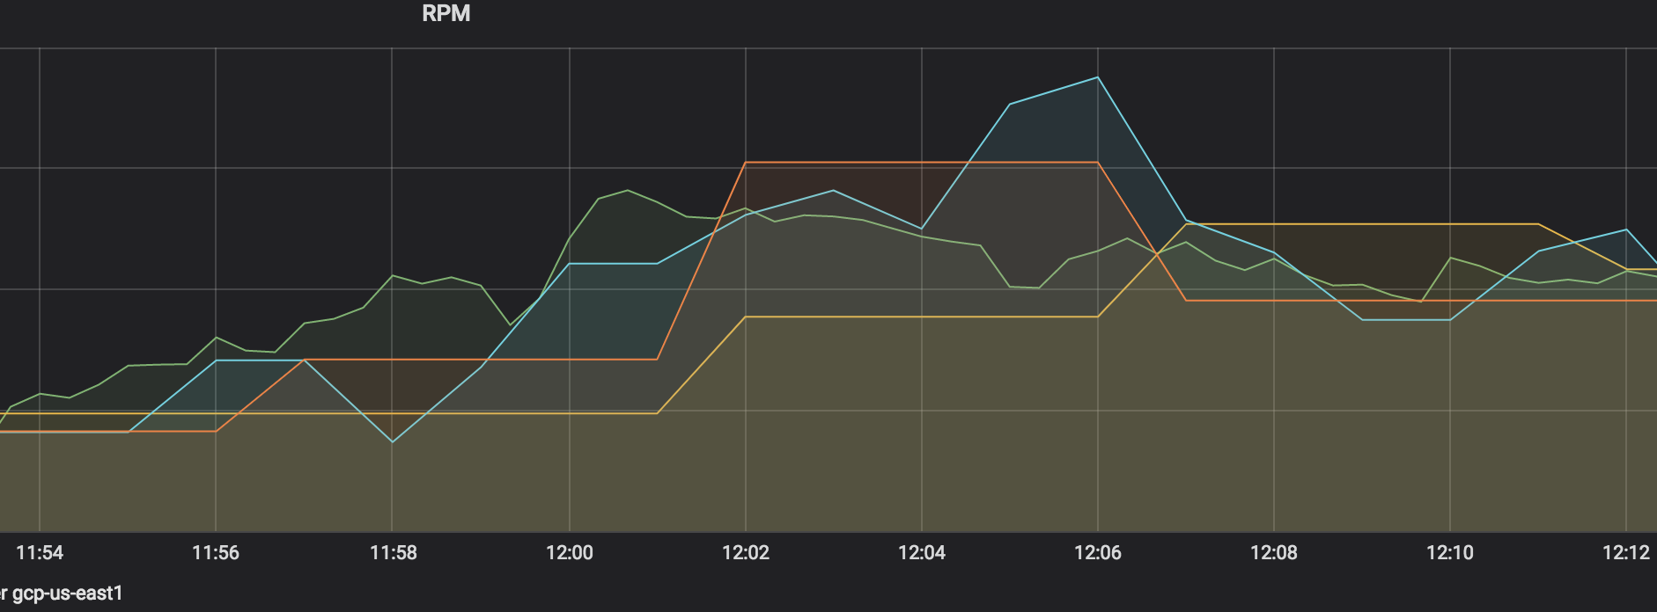
Simulator!
Download past traffic data to local time-series database
Run autoscaler locally
Fast iteration time

Slide 46
Noise Reduction
Notes:
Nodes can take a while to scale down\
Costs money

Slide 47
Running Average Smoothing

Slide 48
Median Smoothing

Slide 49
Spike detection
Notes:
-once in a while, you get unscheduled flashsale, or bot attack, or network problems

Slide 50
Running Average Smoothing
Wasted Resources
Late Reaction
Notes:
average-40

Slide 51
Median Smoothing
No Reaction
Notes:
Not much better

Slide 52
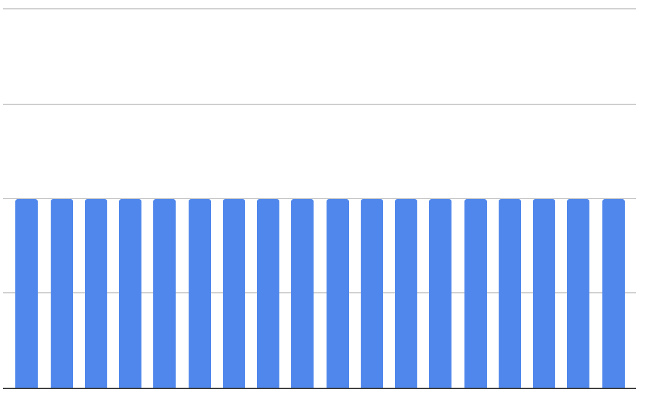
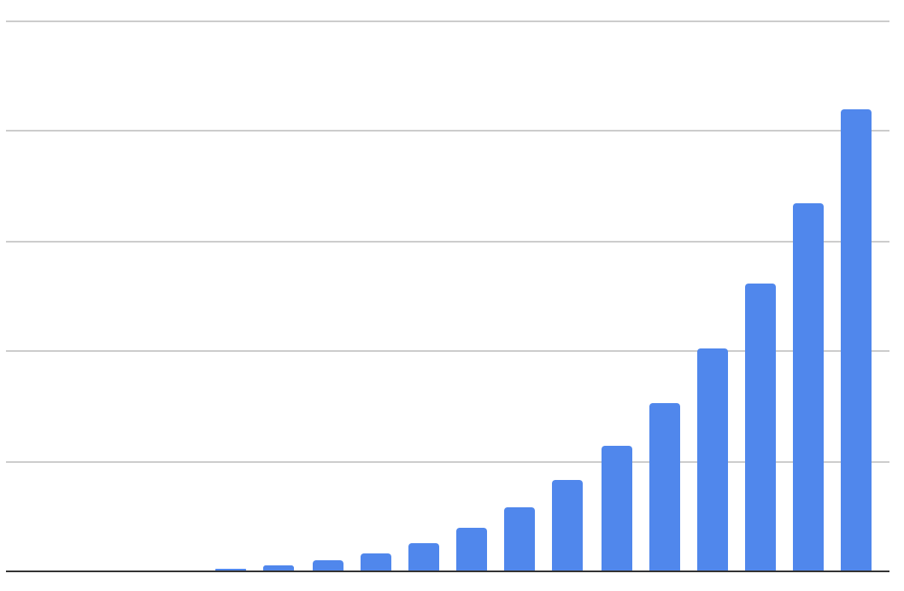
Exponential Weighted Average
Time
Time
Average
All values are weighted equally
Exponential Weighted Avg.
Recent values have much more weight
Notes:
-one sentence

Slide 53
Exponential Weighted Average
Unwanted Noise
Much Better Reaction Time
Notes:
average-40

Slide 54
Double-window Spike detection
EWA is good here
Median is good here
Notes:
Want best of both worlds

Slide 55
Use Both!
No Noise
Switch back to median
Switch to EWA
Notes:
average-40

Slide 56
Algorithm Tuning
Having a simulator is very helpful
Tune your scaling algorithm to solve your particular set of problems

Slide 57
Safety + Resilience
Fallbacks for everything
Scale-to-max if in doubt
Metric Data can be a large source of errors

Slide 58
Data will fail in every conceivable way possible

Slide 59
Data Failure
Many ways data can be wrong
NULL
Value of ‘0’
Stale data
Sparse data
Critical you recognize all cases due to danger of scaling down incorrectly
If there’s any data errors always scale-to-max to be safe
Notes:
retry

Slide 60
Minimum Replica Schedule
Minimum replica value depending on time of day
Prevents unwanted scaledown due to ingress problems or data/calculation errors
Notes:
Saved our butts a couple of weeks ago

Slide 61
Overrides
Scheduled overrides to scale to max capacity
Used by developers
Mostly used for load-testing
Managed through our slack-based CLI
Notes:
-maybe add status screenshot?

Slide 62
When to use your own autoscaler
Deployments with sudden changes in required capacity
Large expensive deployments, where efficiency really matters
Safety & Resilience is critical
Deployments with complex scaling conditions
Notes:
-eg flashsales
-customized algs help with expensive deployments

Slide 63
When NOT to use your own autoscaler
Deployments with smooth, slow-changing traffic patterns
Small deployments that can scale up to maximum capacity quickly
Deployments that don’t require complex scaling rules

Slide 64
CPU Usage - February 2019
39% Average CPU Utilization
Notes:
Avg 3.5 cores- 40%

Slide 65
CPU Usage - August 2019
81% Utilization Average
Still leaves us room for minor unexpected incidents
Huge cost savings
Notes:
Running hot at about 85%
-you can tweak this
-7 figures

Slide 66
Thank you!
andy.kwiatkowski@shopify.com

Slide 67
Rate today ’s session
Session page on conference website
O’Reilly Events App

